Slide 1

Chapter 10：Switching DC Power Supplies
（开关电源）
10-4-4 Push-Pull Converter
10-4-5 Half-Bridge Converter
10-4-6 Full-Bridge Converter

Slide 2
10-4-4 Push-Pull Converter
1 converter circuit
On the primary side, a push-pull inverter is used to produce a square-wave ac voltage at the input of the high-frequency transformer.

Slide 3
On the secondary side, a full-wave rectifier is used to rectify the high-frequency ac voltage into dc voltage.
The switches Q₁ and Q₂ are turned on alternatively, each for an interval t_{on}. thus the transformer be provided by a bidirectional excitation.

Slide 4
D
i
L
I
o
2 Operation principle
1
+
V_{o}
-
+
L
R
+
V_{d}
-
N₁
N₂
u
(1) When T₁ is on and T₂ is off (0<t<t_{on}): D₁ conducts and D₂ gets reverse biased. i_{L} through D₁ increase linearly.
-
oi
N₁
N₂
T
D
2
T₁
T₂
v_{oi}
(a)
N
2
N
U
V_{o}
1
d
0
t
Δ
t
on
T_{s}/2
i_{L}
I_{o}
0
t
(b)

Slide 5
D
i
L
I
o
1
+
V_{o}
-
(2) When T₁ is off and T₂ is on (0<t<t_{on}): D₁ gets reverse biased and D₂ conducts. i_{L} through D₂ increase linearly.
+
L
+
V_{d}
-
u
R
N₁
N₂
oi
-
N₁
N₂
T
D
2
T₁
T₂
v_{oi}
(a)
N
2
N
U
V_{o}
1
d
0
t
Δ
t
on
T_{s}/2
i_{L}
I_{o}
0
t
(b)

Slide 6
D
i
L
I
o
(3) When T₁ and T₂ are off (t_{on}<t<t_{on}+Δ): D₁ and D₂ conduct. i_{L} through D₁ and D₂ decrease linearly.
1
+
V_{o}
-
+
L
R
+
V_{d}
-
N₁
N₂
u
-
oi
N₁
N₂
T
D
2
T₁
T₂
v_{oi}
(a)
N
2
N
U
V_{o}
1
d
0
t
Δ
t
on
T_{s}/2
i_{L}
I_{o}
0
t
(b)

Slide 7
D
i
L
I
o
1
+
V_{o}
-
+
L
R
+
V_{d}
-
N₁
N₂
u
-
oi
In the condition of steady-state:
N₁
N₂
T
D
2
T₁
T₂
v_{oi}
(a)
N
2
N
U
V_{o}
1
d
0
t
Δ
t
on
T_{s}/2
i_{L}
I_{o}
0
t
(b)

Slide 8
D
i
L
I
o
1
+
V_{o}
-
+
L
R
+
V_{d}
-
N₁
N₂
u
-
oi
N₁
N₂
T
D
2
T₁
T₂
v_{oi}
(a)
N
2
N
U
V_{o}
1
d
0
t
Δ
t
on
T_{s}/2
i_{L}
I_{o}
0
t
(b)

Slide 9
Noting:
In practical circuit, the anti- parallel diodes are needed to provide a path for the current required due to leakage flux of the transformer.
Due to a slight and unavoidable difference in the switching times of the two switches T₁ and T₂, there is always an imbalance between the peak values of the two switch current.
i
D
1
L
I
o
+
V_{o}
-
+
L
R
+
V_{d}
-
N₁
N₂
u
-
oi
N₁
N₂
T
D
2
T₁
T₂
v_{oi}
(a)
N
2
N
U
V_{o}
1
d
0
t
Δ
t
on
T_{s}/2
i_{L}
I_{o}
0
t
(b)

Slide 10



An practical Push-Pull dc-dc supply

Slide 11
10-4-5 Half-Bridge Converter
1 converter circuit
Half-Bridge converter requires two split capacitors C_{a} and C_{b} to form a dc input mid-point.
The switches Q₁ and Q₂ are turned on alternatively, each for an interval t_{on}.

Slide 12
2 Operation principle
(Similar to that of push-pull converter)
+
V_{d}
-
D
i
L
I
C₁
T₁
1
o
+
V_{o}
-
+
L
R
+
v₁
-
N₂
u
oi
N₁
-
(1) When T₁ is on and T₂ is off (0<t<t_{on}), D₁ conducts and D₂ gets reverse biased. i_{L} through D₁ increase linearly.
V_{d}/2
N₂
T₂
D
2
C₂
(a)
v_{oi}
N₂V_{d}/2N₁
V_{o}
0
t
Δ
t
on
T_{s}/2
i_{L}
I_{o}
0
t
(b)

Slide 13
(2) When T₁ is off and T₂ is on (0<t<t_{on}), D₁ gets reverse biased and D₂ conducts. i_{L} through D₂ increase linearly.
i
L
+
V_{d}
-
T₁
D
1
I
o
+
V_{o}
-
C₁
L
+
v₁
-
N₂
+
u
R
N₁
-
oi
V_{d}/2
N₂
T₂
D
2
C₂
(a)
v_{oi}
N₂V_{d}/2N₁
V_{o}
0
t
Δ
t
on
T_{s}/2
i_{L}
I_{o}
0
t
(b)

Slide 14
(3) When T₁ and T₂ are off (t_{on}<t<t_{on}+Δ), D₁ and D₂ conduct. i_{L} through D₁ and D₂ decrease linearly.
i
L
+
V_{d}
-
T₁
D
1
I
o
+
V_{o}
-
C₁
L
+
v₁
-
N₂
+
u
R
N₁
-
oi
V_{d}/2
N₂
T₂
D
2
C₂
(a)
v_{oi}
N₂V_{d}/2N₁
V_{o}
0
t
Δ
t
on
T_{s}/2
i_{L}
I_{o}
0
t
(b)

Slide 15
+
V_{d}
-
D
i
L
I
C₁
T₁
1
o
+
V_{o}
-
+
L
R
+
v₁
-
N₂
u
oi
N₁
-
In the condition of steady-state:
V_{d}/2
N₂
T₂
D
2
C₂
(a)
v_{oi}
N₂V_{d}/2N₁
V_{o}
0
t
Δ
t
on
T_{s}/2
i_{L}
I_{o}
0
t
(b)

Slide 16
+
V_{d}
-
D
i
L
I
C₁
T₁
1
o
+
V_{o}
-
+
L
R
+
v₁
-
N₂
u
oi
N₁
-
V_{d}/2
N₂
T₂
D
2
C₂
(a)
v_{oi}
N₂V_{d}/2N₁
What is the role of anti-parallel diode?
V_{o}
0
t
Δ
t
on
T_{s}/2
To provide a path for the current required due to leakage flux of the transformer.
i_{L}
I_{o}
0
t
(b)

Slide 17
An practical Half-Bridge dc-dc supply
What is the role of capacitor C_{b}?

Slide 18
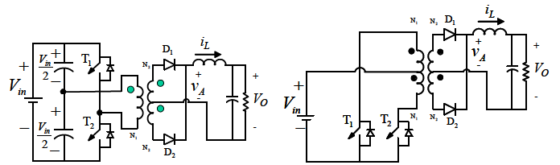
Comparison of the push-pull converter with the half-bridge converter ☆
Push-Pull converter has the advantage of having both transistors gates referenced to the low-side of the input voltage, and has the disadvantage of during the power transfer interval, only one half of the primary windings are utilized.
half-bridge converter
push-pull converter

Slide 19
10-4-6 Full-Bridge Converter
1 converter circuit
Full-bridge isolated buck converter

Slide 20
2 Operation principle
(Similar to that of push-pull converter)
D
i
L
I
+
V_{d}
-
T₁
T₃
1
+
v_{oi}
-
o
+
V_{o}
-
N
+
L
R
+
v₁
-
1
N
2
u
2
-
N
2
D
T₄
T₂
2
(1) When T₃, T₄ are on and T₁, T₂ are off (0<t<t_{on}): D₁ conducts and D₂ gets reverse biased. i_{L} through D₁ increase linearly.
(a)
v_{oi}
N₂V_{d}/N₁
V_{o}
0
t
Δ
t
on
T_{s}/2
i_{L}
I_{o}
0
t
(b)

Slide 21
D
i
L
I
(2) When T₁, T₂ are on and T₃, T₄ are off (0<t<t_{on}): D₁ gets reverse biased and D₂ conducts. i_{L} through D₂ increase linearly.
+
V_{d}
-
T₁
T₃
1
+
v_{oi}
-
o
+
V_{o}
-
N
+
L
R
+
v₁
-
1
N
2
u
2
-
N
2
D
T₄
T₂
2
(a)
v_{oi}
N₂V_{d}/N₁
V_{o}
0
t
Δ
t
on
T_{s}/2
i_{L}
I_{o}
0
t
(b)

Slide 22
D
i
L
I
+
V_{d}
-
T₁
T₃
1
+
v_{oi}
-
o
+
V_{o}
-
(3) When both the switch pairs are off (t_{on}<t<t_{on}+Δ): D₁ and D₂ conduct. i_{L} through D₁ and D₂ decrease linearly.
+
L
R
+
v₁
-
N
1
N
u
2
2
-
N
2
D
T₄
T₂
2
(a)
v_{oi}
N₂V_{d}/N₁
V_{o}
0
t
Δ
t
on
T_{s}/2
i_{L}
I_{o}
0
t
(b)

Slide 23
D
i
L
I
+
V_{d}
-
T₁
T₃
1
+
v_{oi}
-
o
+
V_{o}
-
N
+
L
R
+
v₁
-
1
N
2
u
2
-
N
2
D
In the condition of steady-state:
T₄
T₂
2
(a)
v_{oi}
N₂V_{d}/N₁
V_{o}
0
t
Δ
t
on
T_{s}/2
i_{L}
I_{o}
0
t
(b)

Slide 24
T₁
T₂
T₃
T₄
T₁
T₂
t
T_{s}/2
t_{on}
i_{m}
Δ
t
v₁
V_{d}
t
-V_{d}
N₂V_{d}/N₁
v_{oi}
t
i_{L}
t
i_{D1}
t
i_{D2}
t

Slide 25
An practical Full-Bridge dc-dc supply
What is the role of capacitor C_{b}?

Slide 26
PSpice Modeling:
C:\FirstCourse_PE_Book03\fbsmps.sch

Slide 27
Simulation Results
v₁

Slide 28
Comparison of the full-bridge converter (FB) with the half-bridge converter (HB) ☆
For identical input and output voltages and power ratings requires:
The switch currents I_{T} are:
In large power ratings, it may be advantageous to use a full-bridge converter over a half-bridge converter.

Slide 29
Review Questions
What are the normal specifications of power supplies?
What are the advantages and disadvantages of switch-mode power supplies?
What are the advantages and disadvantages of flyback converters?
What are the advantages and disadvantages of full-bridge converters?
What are the advantages and disadvantages of half-bridge converters?
What are the problems of the transformer core?
Why is the design of a dc inductor different from that of an ac inductor?

Slide 30
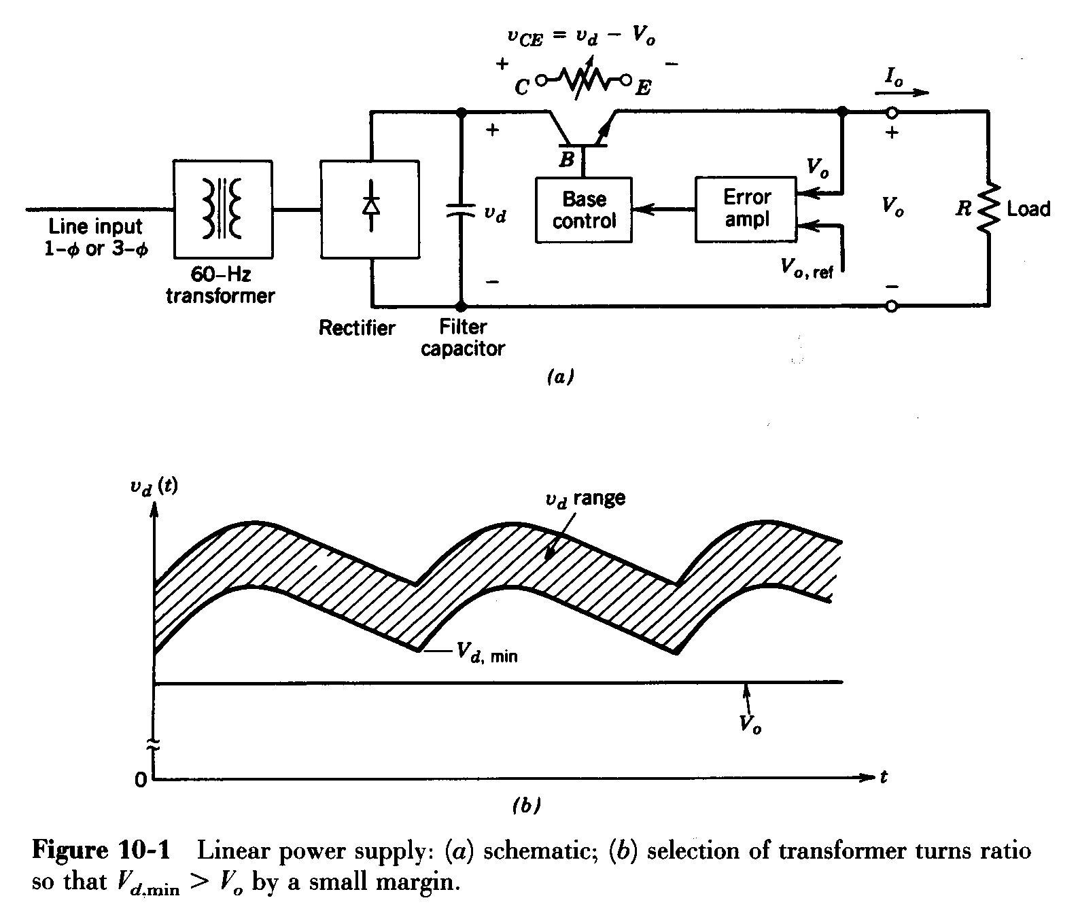
Problem
10-1 A 12-V regulated linear power supply of the type shown in Fig. 10-1a designed to operate with a 60-Hz ac voltage in range of 120V (+10%~-25%). At the maximum load, the peak-to-peak ripple in the capacitor voltage is 1.0V. The power supply is designed such that V_{d,min}-V_{o}=0.5V in Fig.10-1b.
Calculate the loss of efficiency due to power losses in the transistor at full load, with the input voltage at its maximum. (Hint: Approximate the capacitor voltage waveform with straight-line segments.)

Slide 31
Problem
10-2 A flyback converter is operating in a complete demagnetization mode. Derive the voltage transfer ratio V_{o}/V_{d} in terms of the load resistance R, switching frequency f_{s}, transformer inductance L_{m}, and duty ratio D.
10-3 A forward converter with demagnetizing winding is desired to operate wit a maximum duty ratio D_{max} of 0.7. calculate the voltage rating of the switching in terms of the input voltage V_{d}.

Slide 32
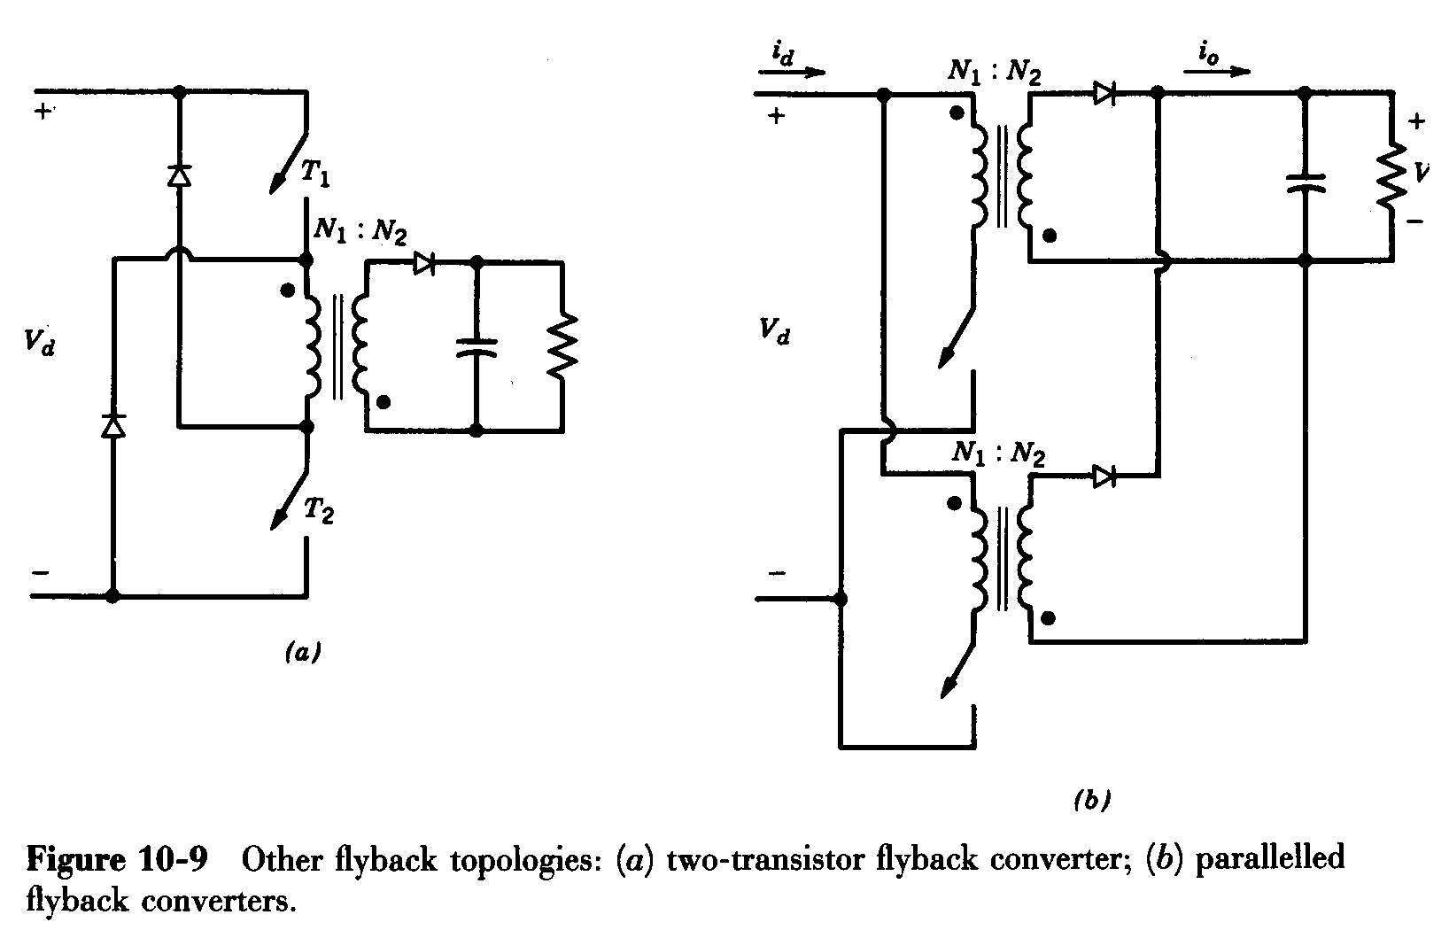
Problem
10-4 A flyback converter is operating in an incomplete demagnetization mode with a duty ratio of 0.4. in the same application, another option may be to parallel two half-size flyback converters as shown in Fig. 10-9b. Compare the ripple in the input current i_{d} and the output stage current i_{o} waveforms in these two options, assuming a very large output capacitor such that v_{o}(t)≈V_{o}.

Slide 33
Problem
10-5 A switch-mode power supply is to be designed with the following specifications: V_{d} =48V±10%, V_{o}=5V, f_{s}=100kHz, P_{load} is 15~50W. A forward converter operating in a continuous-conduction mode with a demagnetizing winding (N₃=N₁) is chosen. Assume all components to be ideal except the presence of transformer magnetization inductance.
D₁
L
i_{L}
i₂
(a) Calculate N₂/N₁ if this turns ratio is desired to be as small as possible.
(b) Calculate the minimum value of the filter inductance.
+ v_{L} -
+
V_{o}
-
+
V_{d}
-
N₁
N₃
N₂
D₂
i₁
i₃
T
D₃
Practical forward converter

Slide 34
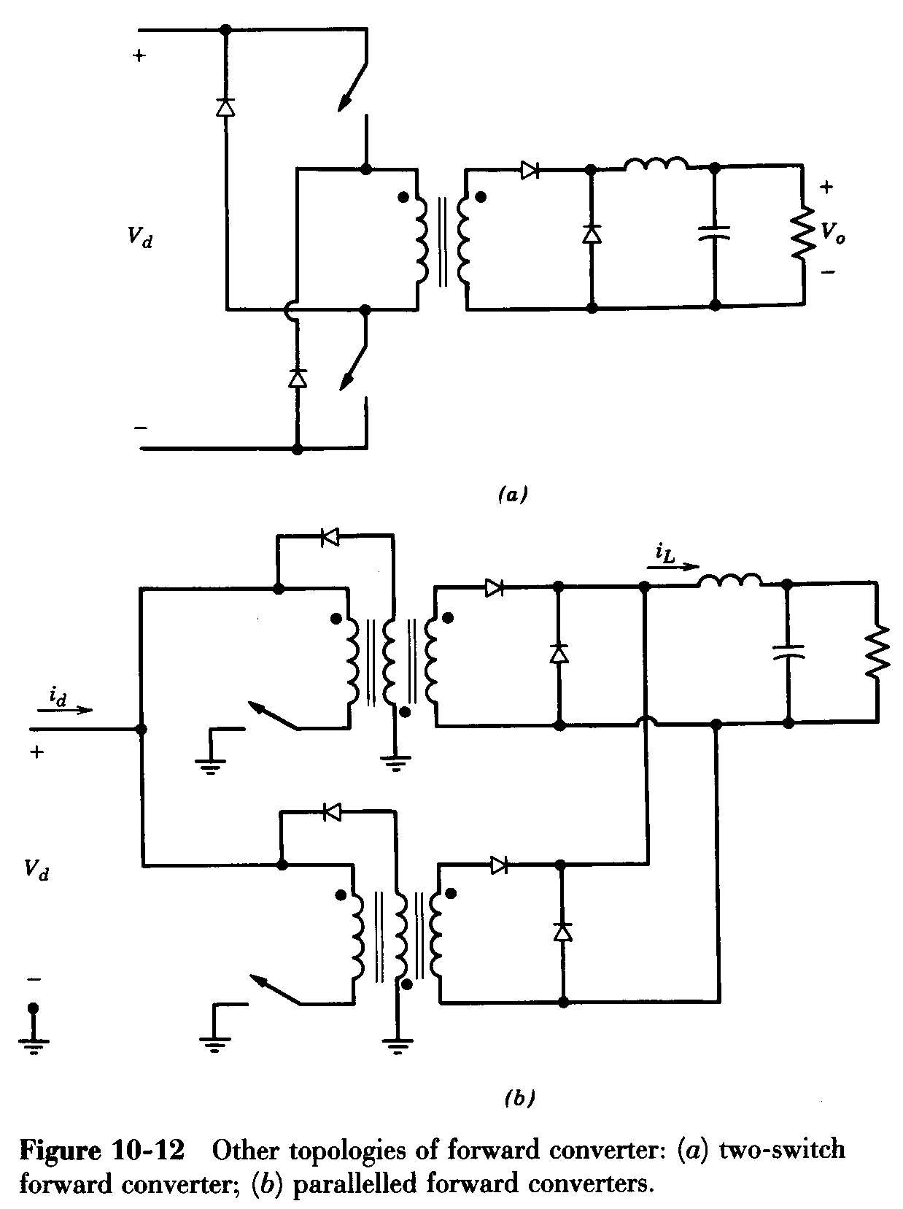
Problem
10-6 In the circuit of Fig. 10-12b with two parallel forward converter, draw the input current i_{d} and i_{L} waveforms if each converter is operating at a duty ratio of 0.3 in a continuous-conduction mode.
Compare these two waveforms with those if a single forward converter (with twice the power rating but with the same value of the output filter inductance as in Fig. 10-12b) is used. Assuming v_{o}(t)≈V_{o}.

Slide 35
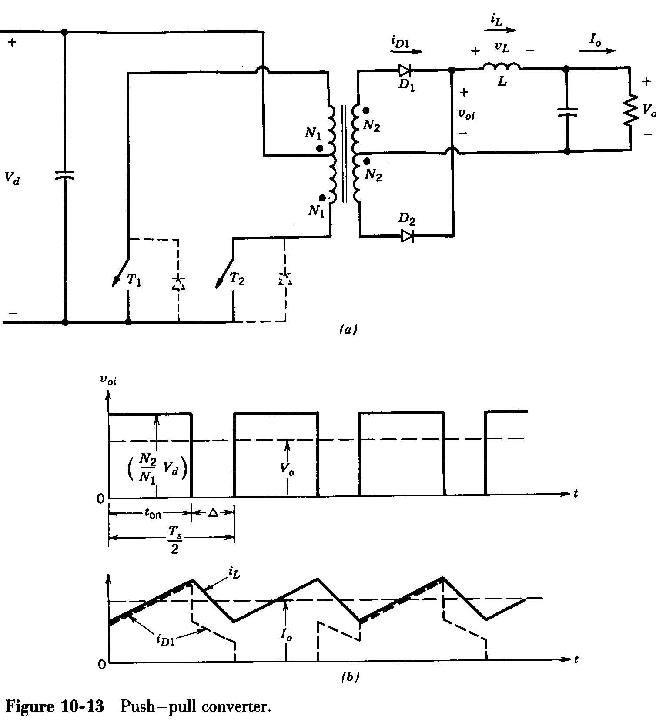
Problem
10-7 In the push-pull converter of Fig. 10-13a, assume the losses to be zero and each switch duty ratio to be 0.25. The transformer has a finite magnetizing inductance and i_{m} is the magnetizing current.
(a) At a large load where i_{L}(N₂/N₁)>>i_{m}, draw the i_{m}, i_{D1}, and i_{D2} waveform.

